Slide 1


Fitness Center
Presented By : - B.Sc.(IT) Semester-VI
Presented By:
Ashish Soni[19082231054]
Shrey Patel [19082231036]
Guided By : Pf. Dhara Darji
Internal Guide name:- Pf. Dhara Darji
Submitted to Department of Computer Science,
GANPAT UNIVERSITY
April - May 2022

Slide 2
Index:-
Project Profile & Objectives
Requirement specification (Existing System)
Need for the New System
Minimum Hardware & Software Requirement
Function Specification
System Flow Chart
ER Diagram
Data Flow Diagram (DFD)
Data Dictionary

Slide 3
1.Project Profile & Objectives
Project Title : - Fitness Center (E-Commerce Website)
Objective :- Fitness Center is used to give online
Selling Equipment, and other products related to fitness.
Developed For :- Online Project Submission
Platform :- Sublime Text 3
Front End Tool :- HTML5,CSS3,Javascript,Jquery
Back End Tool :- PHP (8.0) , MYSQL(8.0.23)
Internal Guide :- Pf. Dhara Darji
External Guide :- Pf. Dhara Darji
Prepared By :- Ashish Soni & Shrey Patel

Slide 4
Existing System
There is no guarantee of good quality equipment in existing system
There is no guarantee of good durability of equipment's in existing system.
There is no guarantee of safe shipping without damaging equipment in existing system

Slide 5
2.Requirement specification (Existing System)
Code Editor | Sublime text editor , VS code
Testing | Chrome
Front-end | Html 5 , CSS3 , java ,
Back-end | MYSQL 5.8, php 8.0
OS | Windows 10
Other software | Xampp 8.0.10

Slide 6

3.Need for New System
There Is A Facility To Buy Online Gym Equipment's.
User Can Not Buy Any Product Without Registration And Login.
User Can Not Log In Without Verification Code At First Time.
User Can Also Get An Offers In Festivals.
There Will Be No False Delivery If There It Is Use Can Complaint It And Resolve In 24 Hour.
After Order Successfully User Can Get The Detail In Mail.

Slide 7
4.MINIMUM HARDWARE REQUIREMENT
Server Configuration :-
Processor | : | Corei3 or Higher
RAM | : | 2 GB
ROM | : | 4 GB (MINIMUM)
Client Configuration :-
Processor | : | Corei3 or Higher
RAM | : | 2 GB
ROM | : | 4 GB (MINIMUM)

Slide 8
MINIMUM SOFTWARE REQUIREMENT
Server Configuration :-
Front End | : | Sublime 3 with php server extension.
Back End | : | SQL Server and apache server
Operating System | : | Windows Server 2008 or Higher
Client Configuration :-
Operating System | : | Windows 10,9,8 or Higher
Browser | : | Internet Explorer 8 or later, Mozilla Firefox 28 or later, Google Chorme 34 or later, Opera 18 or later etc.

Slide 9
5.FUNCTION SPECIFICATION
There are main three Users of this system.
Admin
Manage all the master data
View all the users
Verify the users
Manage the Products
Manage offers
Manage Admin Dashboard
Manage Transactions
viewers
Can see the products
Can search the products
Users
Can see the products
Can search the products
Can buy products
Manage cart
Manage profile

Slide 10
6.System Flow Chart
System flow diagram is a basically a graphical and sequential representation of the major steps involved in a systematic process.
Elements use in this diagrams is mention below .
 | Start-end point : An oval represents a start or end point. The terminator symbol marks the starting or ending point of the system. It usually contains the word “Start” or “End”.
 | Arrow :A line is a connector that shows relationships between the representative shapes.
 | Process :A rectangle represents a process.
 | Decision : A diamond indicates a decision. It appoints where the outcome of a decision dictates the next step. There can be multiple outcomes, but often there are just two – yes and no or true – false, then branches to different parts of the system flow diagram.
 | Input/output :For taking something input from user like form filling or asking for user credentials this symbol is used

Slide 11
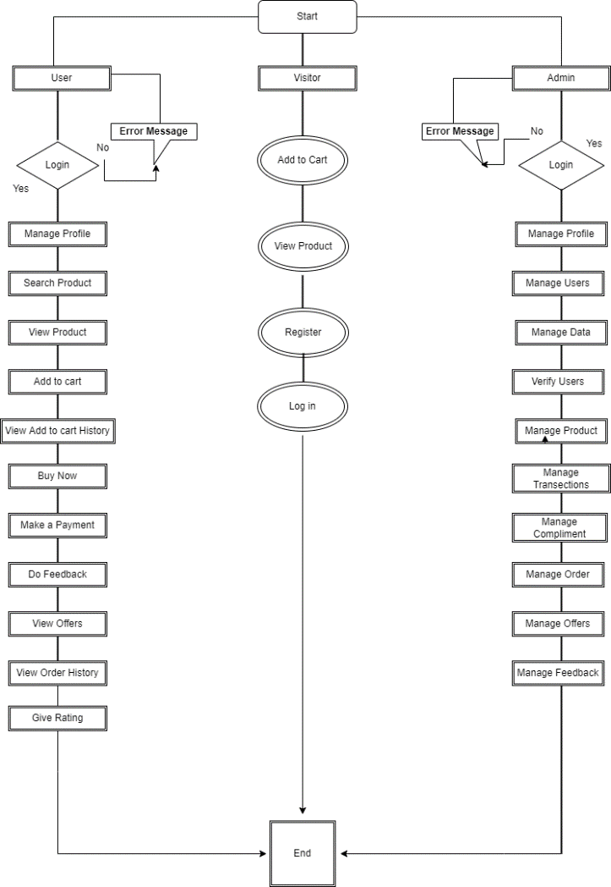
6.System Flow Chart
This diagram show how system works .
The visitor can only able to register.
The user need to login to access full function and if id or password is incorrect then system show an error message .
Same login system works for admin. If id or password is incorrect admin not able to login.

Slide 12
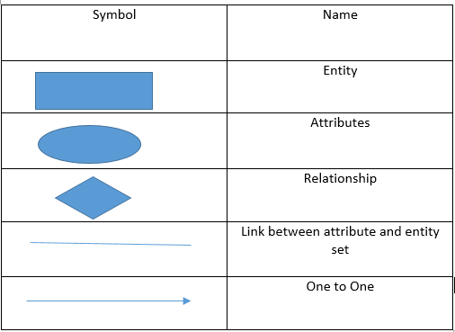
7.ER Diagram
Basic symbol used in E-R diagrams

Slide 13
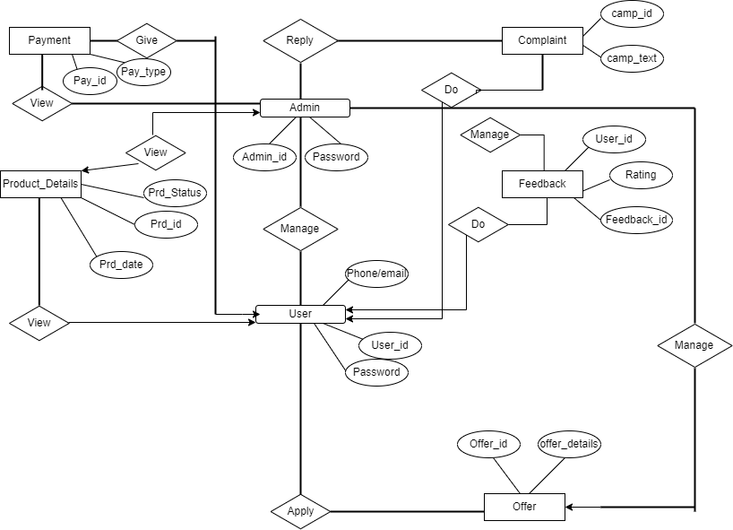
7.ER Diagram

Slide 14
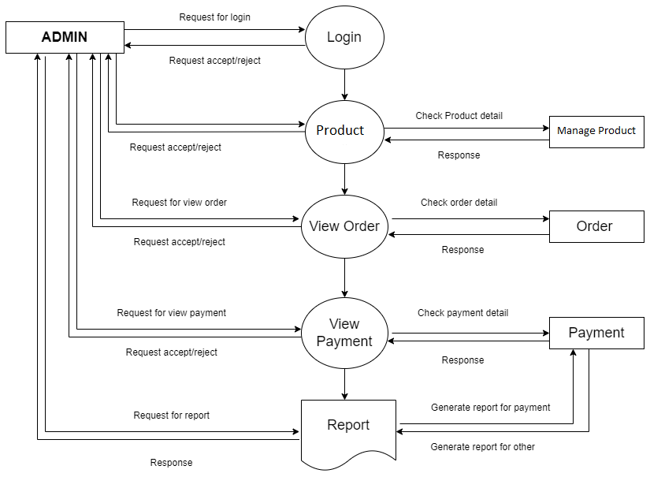
8.Data Flow Diagram
First Level for admin

Slide 15
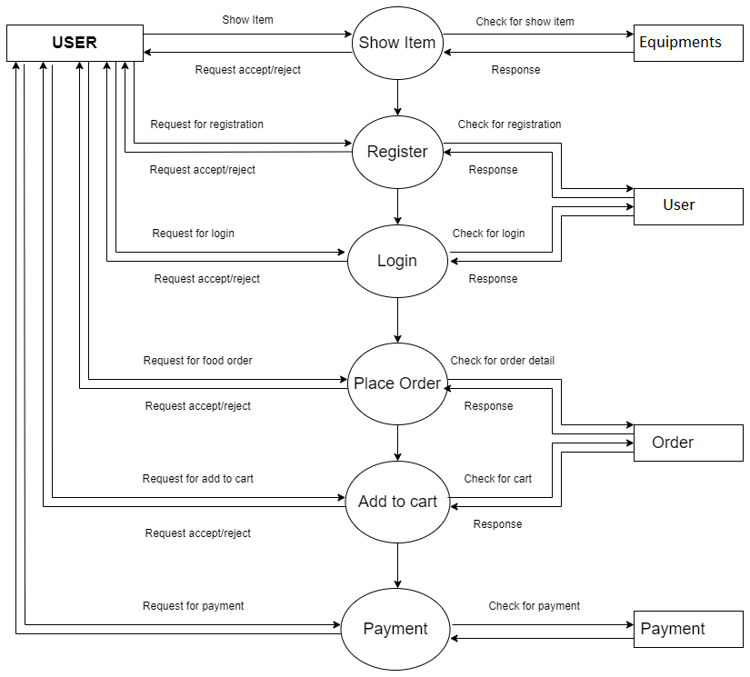
Second Level for User
8.Data Flow Diagram

Slide 16
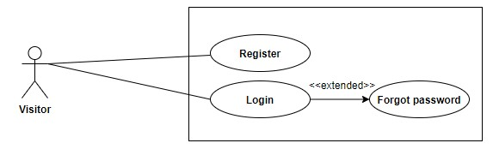
Third Level for Visitor
8.Data Flow Diagram

Slide 17
9.Data Dictionary
Index Of Database
A. Database For Admin Details
B. Database For User Details
C. Database For Order Details
D. Database For Payment Details
E. Database For Feedback Details
F. Database For Complaint Details

Slide 18
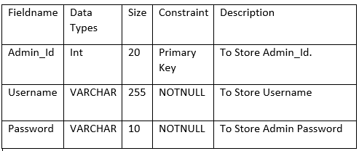
9.Data Dictionary
A. Database for admin
Table Name : Admin_db

Slide 19
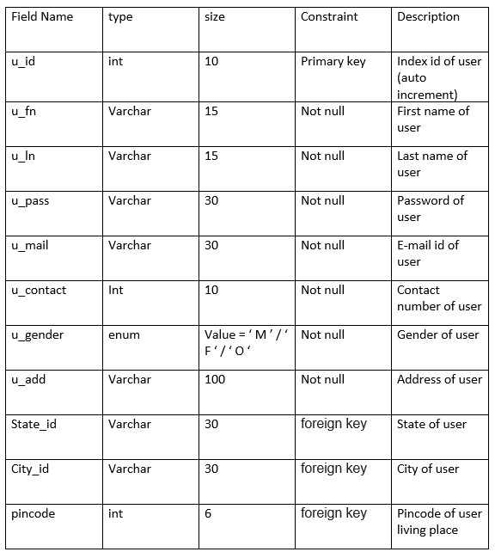
B. Database for user
Table name : user_db
Primary key : u_id
Foreign key : state – state_db
city – city_db
area – area_db

Slide 20
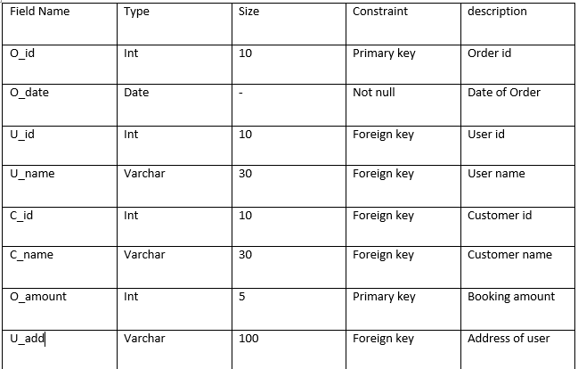
D. Database For Order Details
Table name : order_db
Primary key : o_id
o_amount
Foreign key : u_id – user_db
u_name – user_db
c_id – customer_db
c_name – customer_db
u_add – user_db

Slide 21
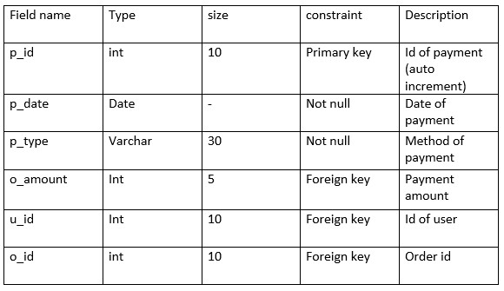
E. Payment Details
Table name : payment_db
Primary key : p_id
Foreign key : p_amount – order_db
u_id

Slide 22
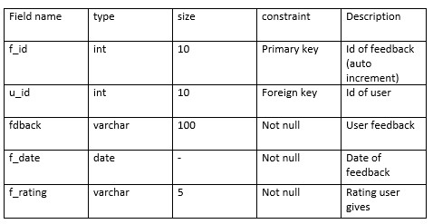
F. Feedback Details
Table name : feedback_db
Primary key : f_id
Foreign key : u_id – user_db

Slide 23
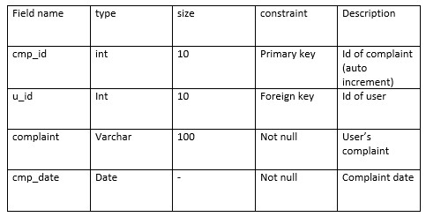
G. Complaint details
Table name : complaint_db
Primary key : cmp_id
Foreign key : u_id – user_db

Slide 24
THANK YOU

